Slide 1

Linear regression analysis
NUTHAN MANIDEEP KUMBHAM

Slide 2

ABSTRACTION
The World Happiness Report 2015 dataset contains data on the happiness levels of people in 159 countries around the world. It includes information on a variety of factors that are thought to contribute to happiness, such as economic factors (GDP per capita), social factors (family, health, and freedom), and trust in government. The data also includes a happiness score and a happiness rank for each country. The happiness score and happiness rank are based on a poll in which people were asked to rate their overall happiness on a scale of 0 to 10. The economy, family, health, freedom, trust, and generosity columns contain various measures of those factors. Overall, the World Happiness Report 2015 dataset provides valuable insights into the factors that contribute to happiness and well-being at the national level, and can be used by researchers, policymakers, and others to better understand and promote happiness around the world.

Slide 3
DATA
.
The dataset can be found on Kaggle and it contains data on happiness levels of people in 159 countries around the world. The data is collected in the year 2015 and it includes information on a variety of factors that are thought to contribute to happiness, such as:
Column Name | Description
Country or Region | Name of the country
Happiness Score | A composite score of overall well-being
Economy (GDP per Capita) | Measure of the economic production of a country
Family | Measure of social support
Health (Life Expectancy) | Measure of the health of citizens
Freedom | Measure of freedom to make life choices
Generosity | Measure of generosity of citizens
Trust (Government Corruption) | Measure of trust in government

Slide 4
Linear regression analysis
The World Happiness Report 2015 dataset was divided into 60% training and 40% validation. The first set, the training set, would be used to fit the linear regression model and would contain 60% of the total data. The second set, the validation set, would be used to evaluate the performance of the model and would contain 40% of the total data.
A full Regression model is fitted by using all predictors. The coefficients of the full model are given in the table
Variable | Estimate | P-value
(Intercept) | 2.0815762 | 1.766181e-14
Economy (GDP per Capita) | 0.8906999 | 2.440296e-03
Family | 1.2251126 | 1.988229e-05
Health (Life Expectancy) | 0.9827672 | 1.862623e-02
Freedom | 1.2324408 | 1.168447e-02
Trust (Government Corruption) | 0.8940511 | 1.232240e-01
Generosity | 0.3319540 | 5.094965e-01
From the table the Economy, Family, Health and Freedom are statically significant because the p-value is less than 0.05.

Slide 5
Linear regression analysis
The Accuracy metrics of full model training data are given in the below table.
The Accuracy metric of full model validation data are given in the below table.
Metric | Value
ME | 1.31e-15
RMSE | 0.505
MAE | 0.390
MPE | -0.992
MAPE | 7.89
Metric | Value
ME | -0.06981036
RMSE | 0.59110420
MAE | 0.47085473
MPE | -2.96841858
MAPE | 9.40502939
There are different variable selection procedures that can be used in linear regression analysis, such as exhaustive search (best subset), forward selection, and backward elimination.

Slide 6
Linear regression analysis
Exhaustive Search (Best Subset): This method involves fitting all possible models with a different combination of variables and selecting the best one based on a certain criterion, such as the lowest AIC or BIC value. Using this method, one can identify the best subset of variables that yield the highest prediction accuracy. The best model chosen in this method would be the one with the lowest AIC/BIC value.
Forward Selection: This method starts with an empty model and iteratively adds one variable at a time, based on a certain criterion, such as the highest p-value. Using this method, one can identify the minimal set of variables that are needed to explain
the response variable.
Backward Elimination: This method starts with a full model that includes all variables and iteratively removes one variable at a time, based on a certain criterion, such as the lowest p-value. Using this method, one can identify the minimal set of variables that are needed to explain the response variable. The best model chosen in this method would be the one that maximizes the p-value of the removed variable.

Slide 7
Linear regression analysis
Model Building
Model-1 is from Forward Selection and Backward Elimination. A linear regression model is fitted by using Economy, Family, Health, Freedom and Trust (Government Corruption). The coefficients of the model-1 are given in the table.
Variable | Estimate | P-value
(Intercept) | 2.1208099 | 1.224656e-15
Economy (GDP per Capita) | 0.8428350 | 2.904128e-03
Family | 1.2273615 | 1.799142e-05
Health (Life Expectancy) | 1.0460853 | 9.989778e-03
Freedom | 1.3117535 | 5.588636e-03
Trust (Government Corruption) | 0.9468206 | 9.851825e-02
From the table the Economy, Family, Health, Freedom and Trust are statically significant because the p-value is less than 0.05.

Slide 8
Linear regression analysis
The Accuracy metrics of model-1 training data are given in the below table
The Accuracy metrics of model-1 validation data are given in the below table.
Metric | Value
ME | 1.946443e-15
RMSE | 5.066885e-01
MAE | 3.930883e-01
MPE | -9.901381e-01
MAPE | 7.956277e+00
Metric | Value
ME | -0.07884785
RMSE | 0.59411122
MAE | 0.47625401
MPE | -3.15213018
MAPE | 9.52431748

Slide 9
Linear regression analysis
Model-2 is from Exhaustive Search. A linear regression model is fitted by using Economy, Family, and Health, Freedom. The coefficients of the model-2 are given in the table.
Variable | Estimate | P-value
(Intercept) | 2.1154526 | 1.943498e-15
Economy (GDP per Capita) | 0.9549486 | 6.311162e-04
Family | 1.1693528 | 4.121804e-05
Health (Life Expectancy) | 0.9864084 | 1.548106e-02
Freedom | 1.6480258 | 1.693580e-04
From the table the Economy, Family, Health and Freedom are statically significant because the p-value is less than 0.05.

Slide 10
Linear regression analysis
The Accuracy metrics of model-2 training data are given in the below table.
The Accuracy metrics of model-2 validation data are given in the below table.
Metric | Value
ME | 1.795258e-15
RMSE | 5.146528e-01
MAE | 4.013407e-01
MPE | -9.831080e-01
MAPE | 8.046654e+00
Metric | Value
ME | -0.08561617
RMSE | 0.59965537
MAE | 0.49029519
MPE | -3.24505690
MAPE | 9.76196052

Slide 11
Linear regression analysis
Model-3 is from Exhaustive Search. A linear regression model is fitted by using Economy, Family, and Freedom. The coefficients of the model-3 are given in the table.
Variable | Estimate | P-value
(Intercept) | 2.308341 | 3.465013e-18
Economy (GDP per Capita) | 1.463224 | 1.665805e-12
Family | 1.207391 | 3.697743e-05
Freedom | 1.559752 | 4.718943e-04
From the table the Economy, Family and Freedom are statically significant.

Slide 12
Linear regression analysis
The Accuracy metrics of model-3 training data are given in the below table.
The Accuracy metrics of model-3 validation data are given in the below table.
Metric | Value
ME | 1.974793e-15
RMSE | 5.319785e-01
MAE | 4.123348e-01
MPE | -1.037603e+00
MAPE | 8.179559e+00
Metrics | Value
ME | -0.088
RMSE | 0.620
MAE | 0.504
MPE | -3.380
MAPE | 10.063
Among all the model-1 with Economy, Family, Health, Freedom and Trust (Government Corruption) is best model with lowest RMSE value.

Slide 13
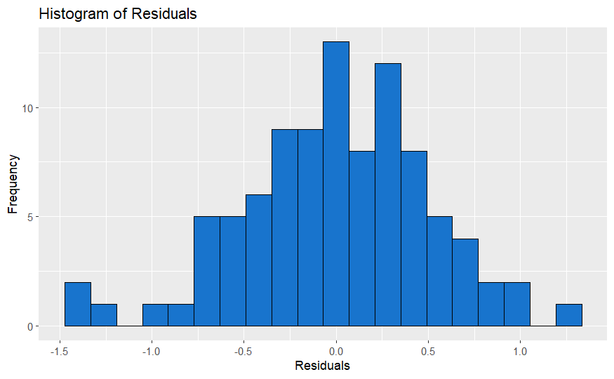
Linear regression analysis
The Histogram residuals of the best model is plotted below.
By observing the histogram of residuals and noting that it closely resembles a normal distribution

Slide 14
CONCLUSION
The model-1, which includes the predictor variables Economy (GDP per Capita), Family, Health (Life Expectancy), Freedom, Trust (Government Corruption), is the best model as it has the lowest residual errors and the residuals are normally distributed. This suggests that these predictor variables have a strong relationship with the target variable Happiness Score and can be used to accurately classify it. This model can be used for future predictions and for understanding the factors that contribute to happiness in a country.

Slide 15

Thank you!

